Slide 1


Monday, November 11 ^{th} , 2019
Hung My I Primary School
English
Class: 3A
Teacher: Nguyen Chi Quan

Slide 2

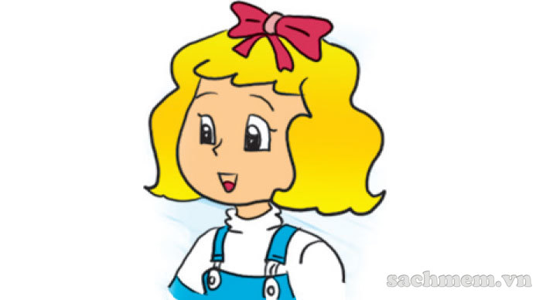
Who’s that?
It’s _____.
Linda

Slide 3
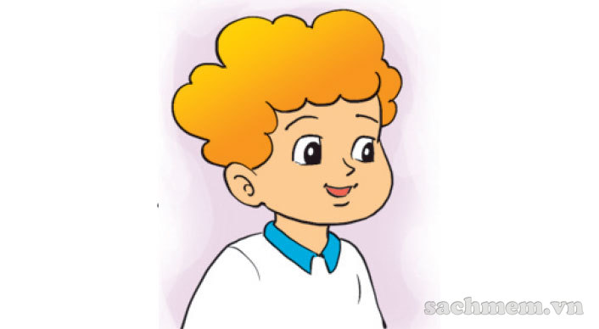
Is that Tony?
No, it isn’t.
It’s Peter.

Slide 4
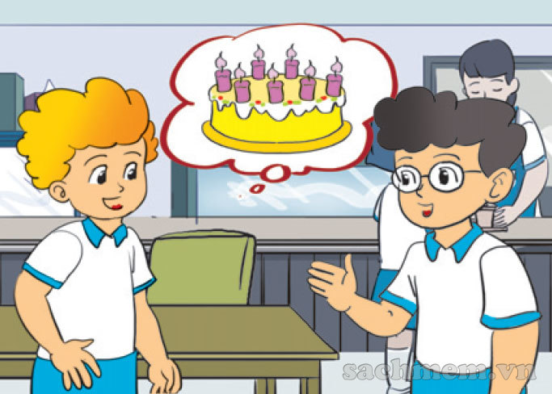
How old are you, Peter?
seven.
I’m ______

Slide 5
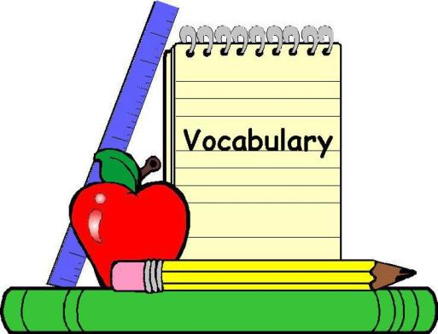
Unit 6: Stand up!
Lesson 1 + 2

Slide 6
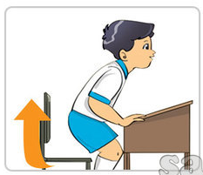
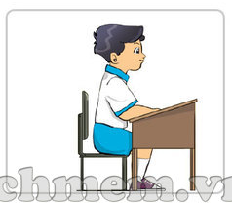
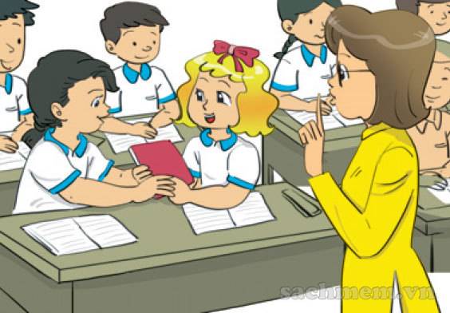


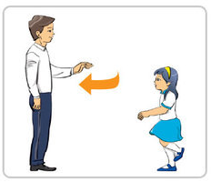
a
b
c
d
e
f
1. Be quiet
2.Stand up
3.Come here
4.Sit down
5.Open your book
6.Close your book

Slide 7

* New words:
sit down: ngồi xuống
stand up: đứng lên
come here: lại đây
be quiet = don’t talk: hãy yên lặng, đừng nói chuyện
open your book : mở sách ra
close your book: đóng sách lại

Slide 8

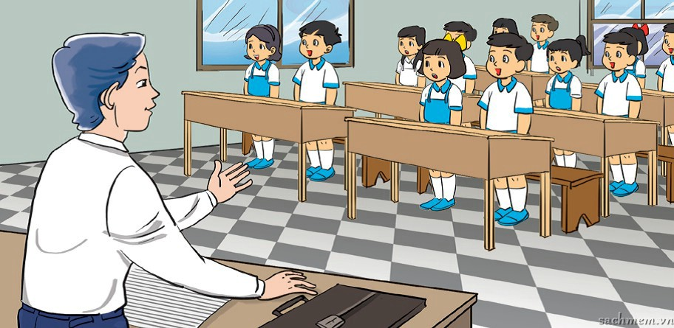
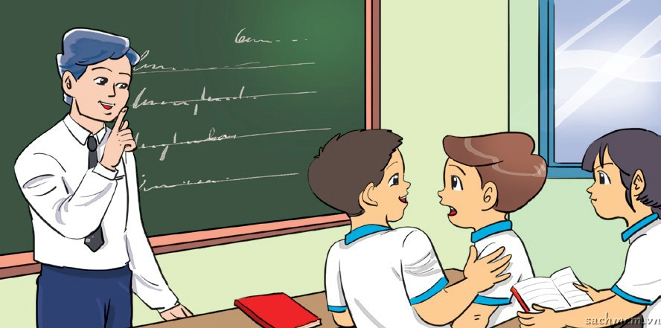
1. Look, listen and repeat.
a
b
Good morning, Mr Loc.
Be quiet, boys!
Good morning, class. Sit down, please!
Sorry, Sir.

Slide 9
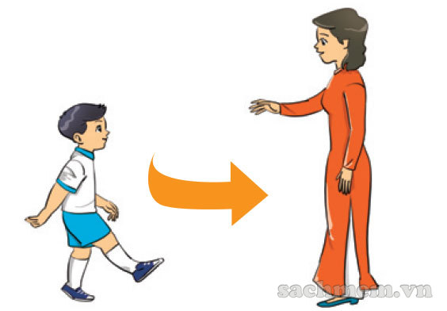

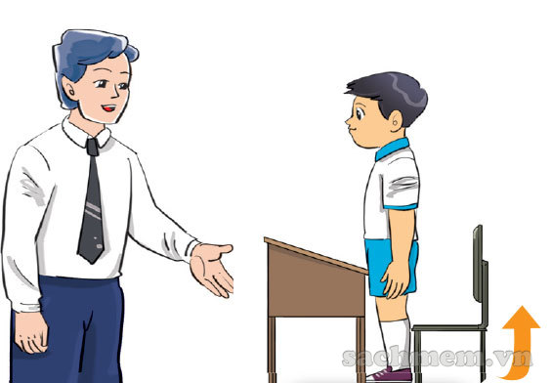
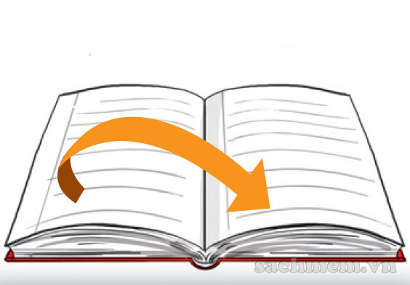
Point, say and do the actions.
Come here
Be quiet / Don’t talk!
Open your book
Close your book
Stand up
Sit down

Slide 10
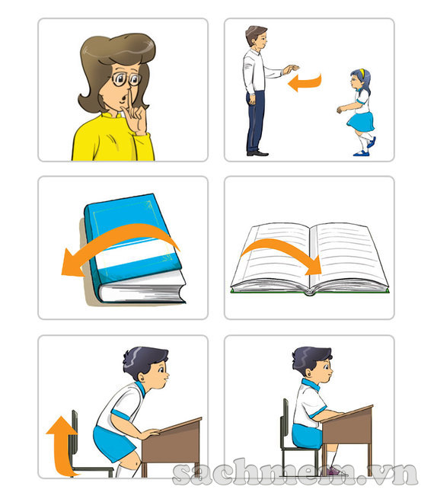
Let’s talk.
1
4
Don’t _________!
2. ______ your book, please!
3. ______ up, please!
4. ______ here, please!
5. ______ your book, please!
6. ______ down, please!
talk
Open
2
5
Stand
Come
Close
Sit
3
6

Slide 11



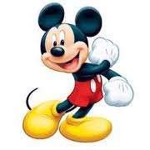






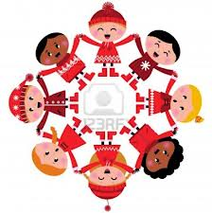
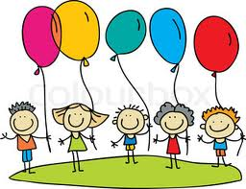

Let’s play
“Guessing”

Slide 12
Be quite / Don’t talk
1
2
3
4

Slide 13
Stand up
1
2
3
4

Slide 14
Open your book
1
2
3
4

Slide 15
Sit down
1
2
3
4

Slide 16


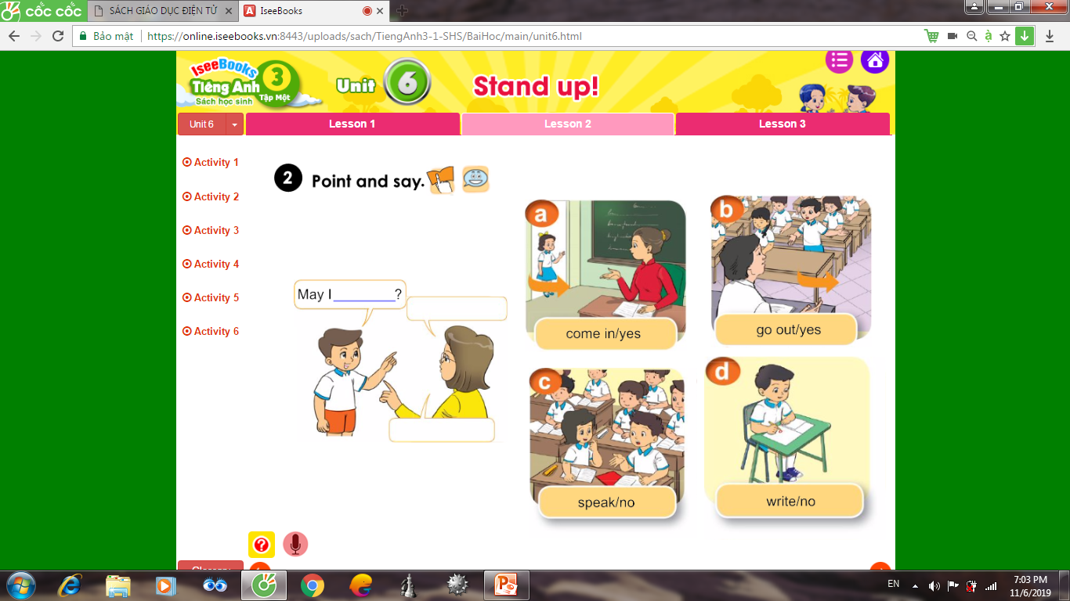

come in:
đi vào

Slide 17
go out :
đi ra ngoài

Slide 18
speak:
nói

Slide 19
write :
viết

Slide 20
TEXTBOOK
PAGE:

Slide 21
New words:
come in :
đi vào
go out :
đi ra ngoài
speak :
nói
write :
viết
may :
xin phép
can :
có thể
can’t :
không thể
Sentences:
Câu xin phép được làm điều gì.
May I come in?
Yes, you can.
No, you can’t.
* can’t = can not
.

Slide 22
Play game: Lucky number
1
2
6
5
3
4
Team A:
Team B:

Slide 23
* Homelink
-Prepare the new lesson.

Slide 24





THANK YOU !

Slide 26


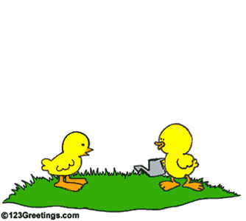
* Lucky number *

Slide 27
May I write?

Slide 28
May I come in?

Slide 29
May I…………. ?
go out
Yes, you can.

Slide 30
May I go out?

Slide 31
May I speak?

Slide 32
* Lucky number *

Slide 33




